Slide 1
Chapter-2 Introduction to Data science
.

Slide 2
Unit objectives
Differentiate data and information
Describe the essence of data science and the role of data scientist
Describe data processing life cycle
Understand different data types from diverse perspectives
Describe data value chain in emerging era of big data.
Understand the basics of Big Data.
Describe the purpose of the Hadoop ecosystem components.

Slide 3
Overview of Data science
Data science is a multi-disciplinary field which involves extracting insights from vast amounts of data using scientific methods, algorithms, and processes.
It helps to extract knowledge and insights from structured, semi structured and unstructured data.
More importantly, it enables you to translate a business problem into a research project and then translate it back into a practical solution.

Slide 4
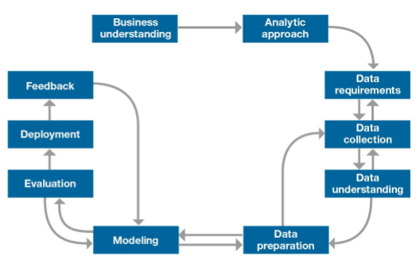
Methodology of data science
Data science methodology

Slide 5
Application of Data science
Data science is much more than simply analyzing data; it plays wide range of roles as follows;
Data is the oil for today's world. With the right tools, technologies, algorithms, we can use data and convert it into a distinctive business advantage
Can help you to detect fraud using advanced machine learning algorithms
It could also helps you to prevent any significant monetary losses
Allows to build intelligence ability in machines
You can perform sentiment analysis to gauge customer brand loyalty.
It enables you to take better and faster decisions.
Helps you to recommend the right product to the right customer to enhance your business.

Slide 6
Data Vs. Information
Data can be defined as a representation of facts, concepts, or instructions in a formalized manner with help of characters such as alphabets (A-Z, a-z), digits (0-9) or special characters (+, -, /, *, <,>, =, etc.)
Those facts are suitable for communication, interpretation, or processing, by human or electronic machines.
Information is an interpreted data; created from organized, structured, and processed data in a particular context on which decisions and actions are based.

Slide 7
Data Processing Cycle
Data processing is re-structuring or re-ordering of data by people or machines to increase their usefulness and add values for a particular purpose.
The following are basic steps of data processing;
Input - in this step, the input data is prepared in some convenient form for processing.
Processing - in this step, the input data is changed to produce data in a more useful form.
For example, a summary of sales for the month can be calculated from the sales orders.
Output − at this stage, the result of the proceeding processing step is collected.
Input
Processing
Output

Slide 8
Data types and their representations
In computer science and computer programming, a data type is simply an attribute of data that tells the compiler or interpreter how the programmer intends to use the data.
A data type makes the values that expression, such as a variable or a function, might take.
This data type defines the operations that can be done on the data, the meaning of the data, and the way values of that type can be stored.

Slide 9
Data types and their representations cont’d
Data types from computer programming perspective;
Almost all programming languages explicitly include the notion of data type with different terminology. Common data types include the following;
Integers(int)- is used to store whole numbers, mathematically known as integers
Booleans(bool)- is used to represent restricted to one of two values: true or false
Characters(char)- is used to store a single character
Floating- point numbers(float)- is used to store real numbers
Alphanumeric strings+(string)- used to store a combination of characters and numbers

Slide 10
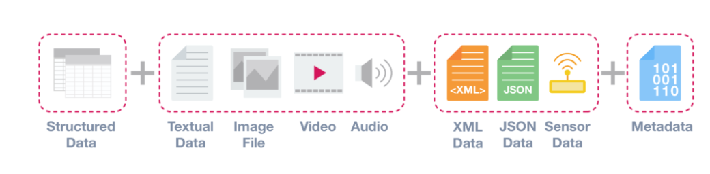
Data types and their representations cont’d
Data types from data analytics perspective:
From data analytics perspective there are three common types of data types or structures: Structured, Semi-structured, and Unstructured data types.
Data types from data analytics perspective

Slide 11
Data types from data analytics perspective cont’d
Structured data:-
Structured data is data that adheres to a pre-defined data model and is therefore straightforward to analyze.
It conforms to a tabular format with a relationship between the different rows and columns
E.g. Excel files, SQL databases
Semi structured data :-
Semi-structured data is a form of structured data that does not conform with the formal structure of data models associated with relational databases .
Contains tags or other markers to separate semantic elements and enforce hierarchies of records and fields within the data
E.g. JSON and XML

Slide 12
Data types from data analytics perspective cont’d
Unstructured data:-
Unstructured data is information that either does not have a predefined data model or is not organized in a pre-defined manner.
Usually it is typically text-heavy but may contain data such as dates, numbers, and facts as well
E.g. audio, video files or NoSQL databases
Metadata :-
Technically metadata is not a separate data structure, but it is one of the most important elements for Big data analysis and solutions.
It provides additional information about a specific set of data; conveniently it can be said data about data
E.g. Date and location of a photograph

Slide 13
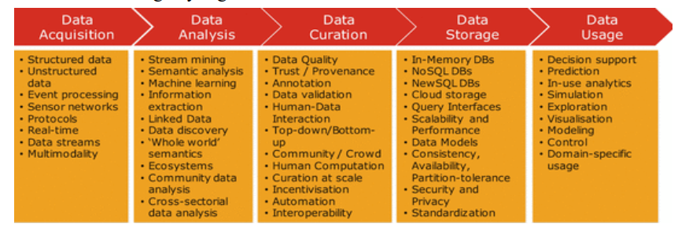
Data value Chain
Data Value Chain describes the information flow within a big data system as a series of steps needed to generate value and useful insights from data.
It identifies the following key high-level activities:-

Slide 14
Data Acquisition
Data acquisition is the process of gathering, filtering, and cleaning data before it is put in a data warehouse or any other storage solution on which data analysis can be carried out.
The infrastructure required for big data acquisition must deliver low, predictable latency in both capturing data and in executing queries.
Moreover, the infrastructure handle very high transaction volumes, often in a distributed environment; and support flexible and dynamic data structures.
Data acquisition is major challenges in big data because of it’s high-end infrastructure requirement.

Slide 15
Data Analysis
Data analysis involves exploring, transforming, and modeling data with the goal of highlighting relevant data, synthesizing and extracting useful hidden information with high potential from a business point of view.
It also deals with making the raw data acquired amenable to use in decision making process

Slide 16
Data Curation
Data curation is an active management of data over its life cycle to ensure it meets the necessary data quality requirements for its effective usage.
It’s process can be categorized into different activities such as content creation, selection, classification, transformation, validation, and preservation.
Data curation is performed by expert curators or annotators that are responsible for improving the accessibility and quality of data.

Slide 17
Data Storage
Data storage is the persistence and management of data in a scalable way that satisfies the needs of applications that require fast access to the data.
Relational database system has been used as a storage paradigm for over 40 years.
Following the volume and complexity of data recently highly scalable NoSQL technologies is applied for big data storage model.

Slide 18
Data Usage
Data usage covers the data-driven business activities that need access to data, its analysis, and the tools needed to integrate the data analysis within the business activity.
It enhances business decision making competitiveness through the reduction of costs, increased added value, or any other parameter that can be measured against existing performance criteria.

Slide 19
Basic concepts of big data
What is big data?
Big data is the term for a collection of data sets.
so large and complex that it becomes difficult to process using on-hand database management tools or traditional data processing applications.
The common scale of big datasets is constantly shifting and may vary significantly from organization to organization.
Big data is characterized by 4V’s actually beyond this:-
Volume: large amounts of data Zeta bytes/Massive datasets
Velocity: Data is live streaming or in motion
Variety: data comes in many different forms from diverse sources
Veracity: can we trust the data? How accurate is it?

Slide 20
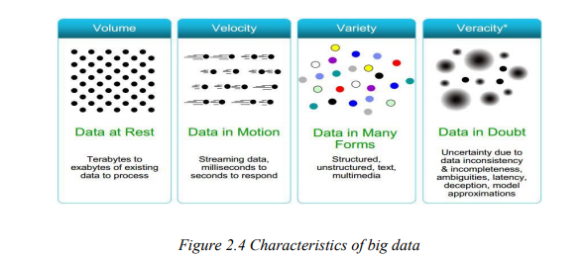
Big data cont’d
The following figure depicts the 4V’s of big data

Slide 21
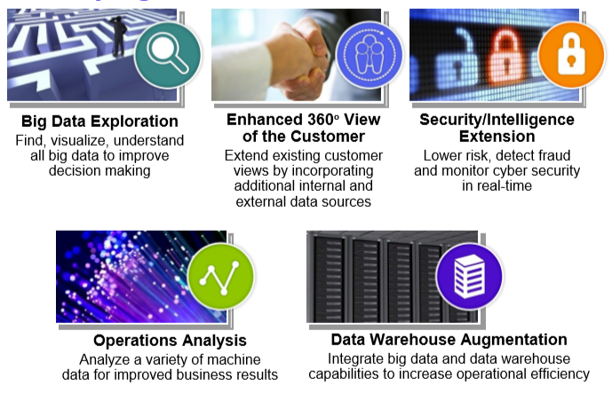
Big data cont’d
The following figure depicts the 5 major use cases of big data

Slide 22
Clustered Computing and Hadoop Ecosystem
Clustered Computing
Because of the qualities of big data, individual computers are often inadequate for handling the data at most stages.
To better address the high storage and computational needs of big data, computer clusters are a better fit.
Big data clustering software combines the resources of many smaller machines, seeking to provide a number of benefits such as:
Resource Pooling: combining storage space and cpu to process large dataset
High Availability: Clusters can provide varying levels of fault tolerance and availability
Easy Scalability: Clusters make it easy to scale horizontally by adding additional machines to the group.

Slide 23
Clustered Computing cont’d
Employing clustered resources may require managing cluster membership, coordinating resource sharing, and scheduling actual work on individual nodes or computers.
The cluster membership and resource allocation task is done by apache open source framework software's like Hadoop's YARN(which stands for Yet Another Resource Negotiator.)
The assembled cluster machines act seamlessly and help other software interfaces to process the data.

Slide 24
Hadoop and its Ecosystem
What is Hadoop?
It’s apache open source software framework for reliable, scalable, distributed computing of massive amount of data
Hides underlying system details and complexities from user
Developed in Java
Flexible, enterprise-class support for processing large volumes of data
Inspired by Google technologies (MapReduce, GFS, BigTable, …)
Initiated at Yahoo : to address scalability problems of an open source web technology(Nutch)
Supports wide variety of data

Slide 25
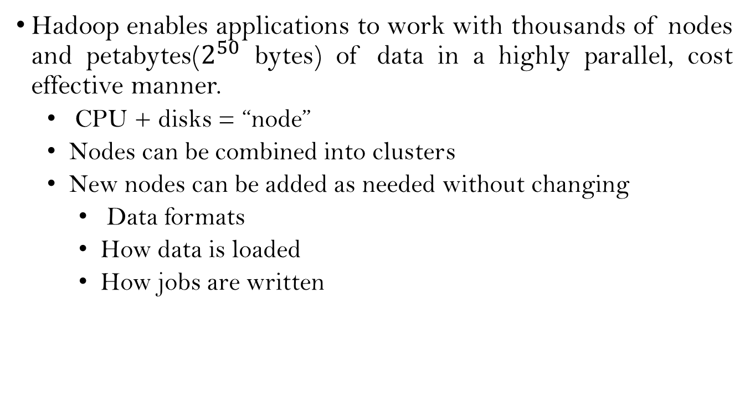
Hadoop and its Ecosystem Cont’d
Hadoop enables applications to work with thousands of nodes and petabytes($2^{50}$ bytes) of data in a highly parallel, cost effective manner.
CPU + disks = “node”
Nodes can be combined into clusters
New nodes can be added as needed without changing
Data formats
How data is loaded
How jobs are written

Slide 26
Hadoop and its Ecosystem Cont’d
Hadoop is supplemented by an ecosystem of open source projects such as:
HDFS: Hadoop Distributed File System
YARN: Yet Another Resource Negotiator
MapReduce: Programming based Data Processing
Spark: In-Memory data processing
PIG, HIVE: Query-based processing of data services
HBase: NoSQL Database
Mahout, Spark MLLib: Machine Learning algorithm libraries
Solar, Lucene: Searching and Indexing
Zookeeper: Managing cluster
Oozie: Job Scheduling

Slide 27
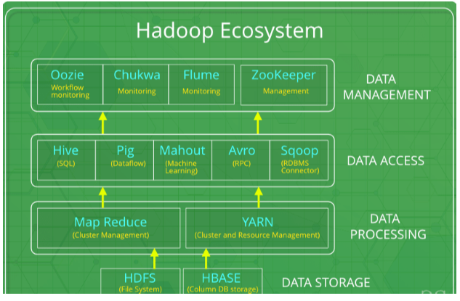
Hadoop and its Ecosystem Cont’d
Hadoop has an ecosystem that has evolved from its four core components: Data management, access, processing, and storage.
The following figure depict Hadoop ecosystem

Slide 28
Life cycle of big data with Hadoop
Ingesting data into the system
First the data is ingested or transferred to Hadoop from various sources such as relational databases, systems, or local files.
Sqoop transfers data from RDBMS to HDFS, whereas Flume transfers event data
Processing the data in storage
The second stage is Processing. In this stage, the data is stored and processed.
The data is stored in the distributed file system, HDFS, and the NoSQL distributed data, HBase. Spark and MapReduce perform data processing

Slide 29
Life cycle of big data with Hadoop Cont’d
Computing and analyzing data
The third stage is analyzing and processing data using open source frameworks such as Pig, Hive, and Impala.
Pig converts the data using a map and reduce and then analyzes it.
Hive is also based on the map and reduce programming and is most suitable for structured data
Visualizing the results
The fourth stage is Access, which is performed by tools such as Hue and Cloudera Search.
In this stage, the analyzed data can be accessed by users.

Slide 30

Any Question?

